Slide 1


PBIP and Fabric API Deployment
Jake Duddy
Lead Metrics Developer @ HSBC
linkedin.com/in/jakeduddy/
evaluationcontext.github.io/

Slide 2
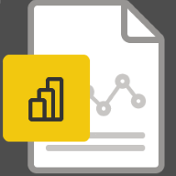


What is Power BI?
Power BI
Semantic Model
Report
SSAS Tabular
Columnstore Database
Tabular Object Model (TOM)

Slide 3
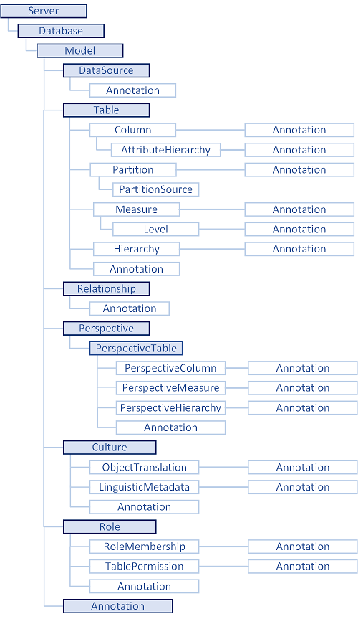
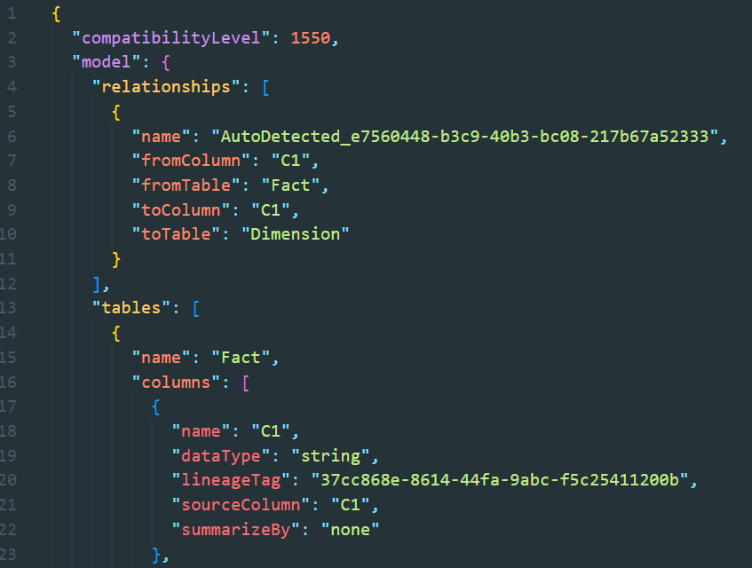
Tabular Object Model (TOM)
Defined schema to describe SSAS Tabular Models
Structured as json (model.bim) [TMSL]
https://learn.microsoft.com/en-us/analysis-services/tom/introduction-to-the-tabular-object-model-tom-in-analysis-services-amo

Slide 4
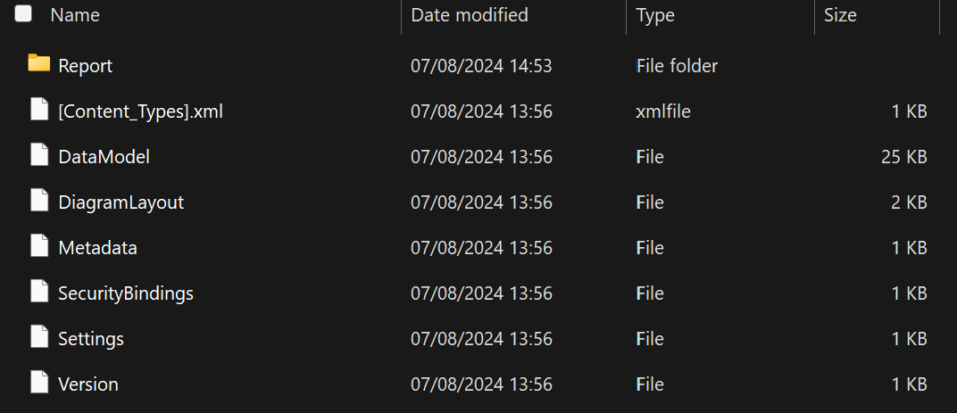

What happens if we unzip a .pbix?
Power BI
You can unzip a .pbi, but thesefiles are not very useful

Slide 5
Power BI Project (PBIP)
Power BI Report binary File (.pbix) decompiled into Folder and File Structure
Semantic Model and Report are represented as separate Fabric Items
Each Item type in Microsoft Fabric has different supported formats and required Parts (files) that make up its definition
Only some parts are mandatory
Brings Source Control (git) to Power BI
📁
┕━━ 📁 <project name>.SemanticModel
┕━━ 📁 <project name>.Report
┕━━ 📄 .gitignore
┕━━ 📄 <project name>.pbip # shortcut to open report & model for
authoring with Power BI Desktop
https://learn.microsoft.com/en-us/power-bi/developer/projects/projects-overview

Slide 6
Power BI Project (PBIP): Semantic Model
Model.bim (TMSL) or TMDL
📁
┕━━ 📁 <project name>.SemanticModel
┕━━ 📁 .pbi
│ ┕━━ 📄 localSettings.json # gitignore
│ ┕━━ 📄 editorSettings.json
│ ┕━━ 📄 cache.abf # gitignore
│ ┕━━ 📄 unappliedChanges.json
┕━━ 📄 definition.pbism # Required
┕━━ 📄 model.bim # .bim (TMSL) or
┕━━ 📁 definition # definition folder (TMDL) required
┕━━ 📄 diagramLayout.json
┕━━ 📄 .platform
https://learn.microsoft.com/en-us/power-bi/developer/projects/projects-dataset
https://learn.microsoft.com/en-us/rest/api/fabric/articles/item-management/definitions/semantic-model-definition

Slide 7
Power BI Project (PBIP): Report
Report.json or PBIR format
definition.pbir points to Semantic Model either byConnection or byPath
Fabric API only supports byConnection
📁
┕━━ 📁 <project name>.Report
┕━━ 📁 .pbi
│ ┕━━ 📄 localSettings.json # gitignore
┕━━ 📁 CustomVisuals
┕━━ 📁 StaticResources
│ ┕━━ 📁 RegisteredResources
┕━━ 📄 definition.pbir # Pointer to Semantic Model. Required
┕━━ 📄 report.json # report.json or
┕━━ 📁 definition # definition folder required
┕━━ 📄 semanticModelDiagramLayout.json
┕━━ 📄 mobileState.json
┕━━ 📄 .platform
https://learn.microsoft.com/en-us/power-bi/developer/projects/projects-report
https://learn.microsoft.com/en-us/rest/api/fabric/articles/item-management/definitions/report-definition

Slide 8






Deployment Methods
Git Integration
Fabric Workspace connected to Azure DevOps (ADO) Repo branch
or GitHub
Fabric Items can be synced both ways
GUI or Fabric APIs
Fabric REST APIs
Create Item
Update Item Definition
ADO
Fabric
Workspace
Semantic Models
Reports
Post
/workspaces/{workspaceId}/items/{itemId}/updateDefinition
Post
/workspaces/{workspaceId}/items
https://learn.microsoft.com/en-us/fabric/cicd/git-integration/intro-to-git-integration
https://learn.microsoft.com/en-us/rest/api/fabric/core/items
Notes:
https://github.com/microsoft/Analysis-Services/tree/master/pbidevmode
# Install-Module Az.Accounts -Scope CurrentUser -Force
$tenantId = "2a1d3328-87c0-4f85-90c6-0bb69b1c4978"
Import-Module "$pwd\FabricPS-PBIP" -Force
Set-FabricAuthToken -tenantId $tenantId -reset
Import-FabricItems -workspaceId "75605c88-438e-43a2-95c8-07e3bdf6e3c4" -path $pwd

Slide 9

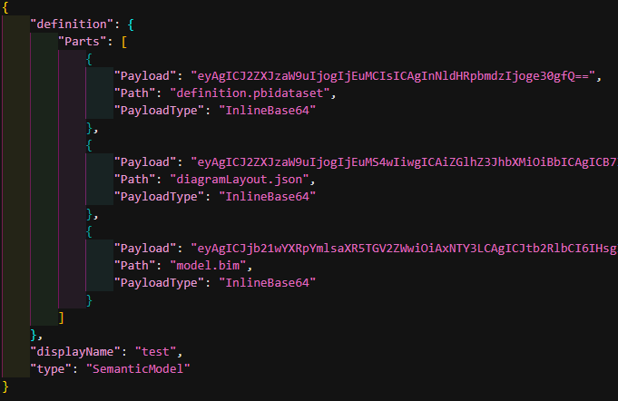
Example Request
URI
Header
Body
Post
/workspaces/{workspaceId}/items/{itemId}/updateDefinition

Slide 10
Deployment Script
Microsoft has an example some example PowerShell and pipelines to get you started
https://github.com/microsoft/Analysis-Services/blob/master/pbidevmode/fabricps-pbip/FabricPS-PBIP.psm1

